Slide 1

CUSTOMER CHURN PREDICTION PROJECT
BY MAHMUD M. NYAKO

Slide 2
INTRODUCTION
ConnectTel Telecom Company faces the pressing need to address customer churn, which poses a significant threat to its business sustainability and growth. The company's current customer retention strategies lack precision and effectiveness, resulting in the loss of valuable customers to competitors. To overcome this challenge, ConnectTel aims to develop a robust customer churn prediction, and also seek to accurately forecast customer churn and implement targeted retention initiatives.
If at the beginning of the month the company had 7000 + customers, 2000 left. That represents a 28.6% customer churn for the month.
Customer Churn (our target variable) is an important metric to look at since its more expensive to acquire new customers than to retain one.

Slide 3
Problem Statement:
ConnectTel Telecom Company is experiencing a high rate of customer churn, which is negatively impacting its business. The existing customer retention strategies are not effectively identifying customers at risk of leaving, leading to a loss of revenue and market share. The company aims to implement a proactive approach to predict customer churn accurately and implement targeted retention initiatives.
There are 3 ways in which businesses generate more revenue:
1. Upsell to existing customers.
2. Acquire new customers.
3. Increase customer retention.

Slide 4
Objectives:
Develop a Churn Prediction System:
Creating a machine learning model that accurately predicts whether a customer is likely to churn based on historical data and relevant features.
Implement Targeted Retention Initiatives:
Utilize the churn prediction model to identify high-risk customers.
Design and implement targeted retention initiatives for identified at-risk customers to reduce churn rates.
Enhance Customer Loyalty:
Improve overall customer satisfaction and loyalty by addressing potential churn factors identified through the model.
Tailor services, promotions, or communication strategies to meet customer needs and expectations.
Maintain Competitive Edge:
Stay ahead in the highly dynamic and competitive telecommunications industry by adopting a proactive and data-driven approach to customer retention.
Position ConnectTel as a customer-centric company that values and understands its customer base.

Slide 5
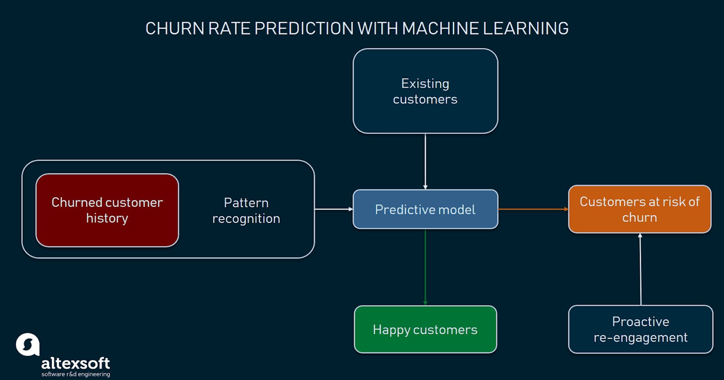
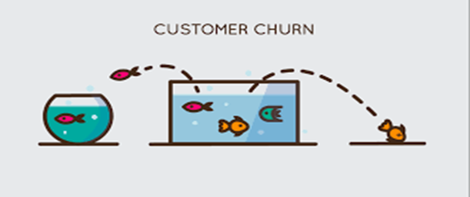

Slide 6
Data Cleaning: data types
0 customerID 7043 non-null object
1 gender 7043 non-null object
2 SeniorCitizen 7043 non-null int64
3 Partner 7043 non-null object
4 Dependents 7043 non-null object
5 tenure 7043 non-null int64
6 PhoneService 7043 non-null object
7 MultipleLines 7043 non-null object
8 InternetService 7043 non-null object
9 OnlineSecurity 7043 non-null object
10 OnlineBackup 7043 non-null object
11 DeviceProtection 7043 non-null object
12 TechSupport 7043 non-null object
13 StreamingTV 7043 non-null object
14 StreamingMovies 7043 non-null object
15 Contract 7043 non-null object
16 PaperlessBilling 7043 non-null object
17 PaymentMethod 7043 non-null object
18 MonthlyCharges 7043 non-null float64
19 TotalCharges 7032 non-null float64
20 Churn 7043 non-null object
dtypes: float64(2), int64(2), object(17)

Slide 7
Investigation of the dataset
It was observed that Total Charges had 11 rows with missing data.
The missing values were dropped from the dataset.
The dataset has diverse customer related features, along with a churn label for each customer record, denoting whether they had churned or not.
I checked for outliers in the numerical data and found none.
I performed a correlation analysis, to examine the relationships between the different variables.

Slide 8
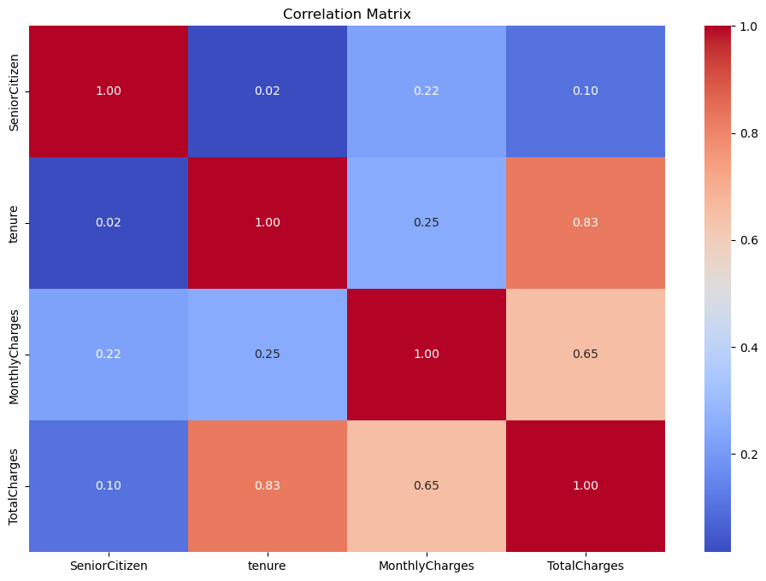
CORRELATION MATRIX

Slide 9
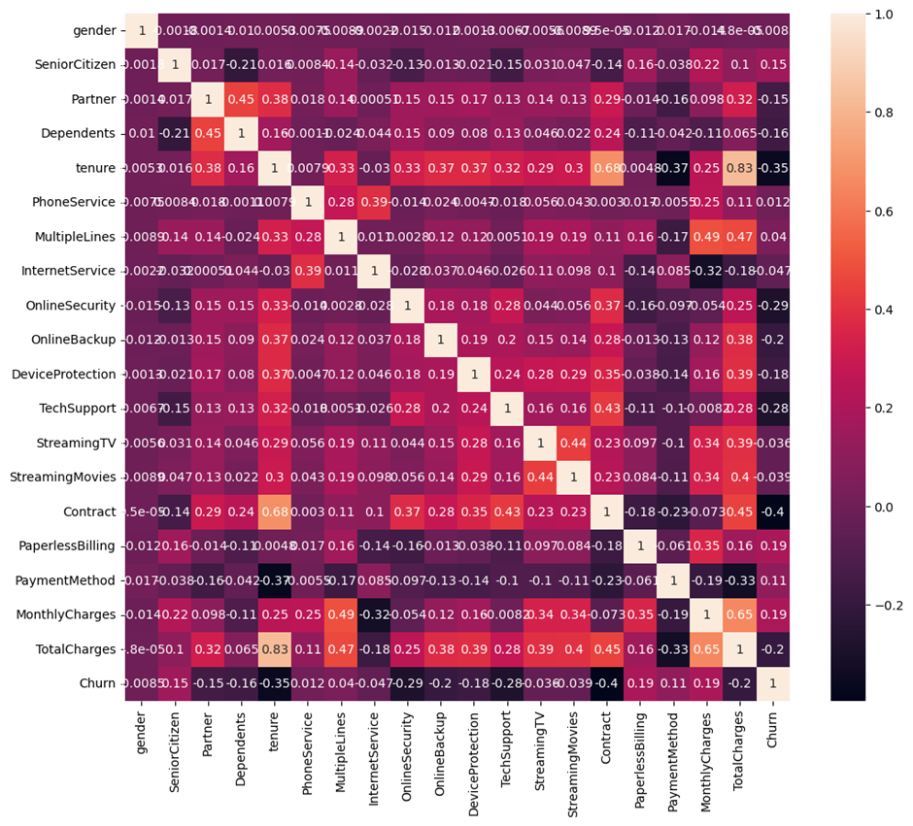
Relationship between Churn and other values

Slide 10
Feature Engineering:
Handle Missing Data: by dropping missing values.
Converted ‘No internet service’ and ‘No Phone Service’ to ‘No’.
Performed EDA to visualize and understand the data set.
Encode Categorical Variables: Converted categorical variables (i.e., gender, contract type) into numerical representations using label encoding. This will allow machine learning algorithms to work with categorical data.
Scaling of Numerical Features: Standardizing/normalizing numerical features to ensure they have similar scales, which can improve the performance of some machine learning algorithms.
I revisited my feature engineering after model evaluation to refine and improve the predictive performance of the model.

Slide 11
Feature Information
gender
['Female' 'Male']
2
SeniorCitizen
[0 1]
2
Partner
['Yes' 'No']
2
Dependents
['No' 'Yes']
2
PhoneService
['No' 'Yes']
2
MultipleLines
['No phone service' 'No' 'Yes']
3
InternetService
['DSL' 'Fiber optic' 'No']
3
OnlineSecurity
['No' 'Yes' 'No internet service']
3
OnlineBackup
['Yes' 'No' 'No internet service']
3
DeviceProtection
['No' 'Yes' 'No internet service']
3
TechSupport
['No' 'Yes' 'No internet service']
3
StreamingTV
['No' 'Yes' 'No internet service']
3
StreamingMovies
['No' 'Yes' 'No internet service']
3
Contract
['Month-to-month' 'One year' 'Two year']
3
PaperlessBilling
['Yes' 'No']
2
PaymentMethod
['Electronic check' 'Mailed check' 'Bank transfer (automatic)'
'Credit card (automatic)']
4
MonthlyCharges
[29.85 56.95 53.85 ... 63.1 44.2 78.7 ]
1585
TotalCharges
[ 29.85 1889.5 108.15 ... 346.45 306.6 6844.5 ]
6530
Churn
['No' 'Yes']
2

Slide 12
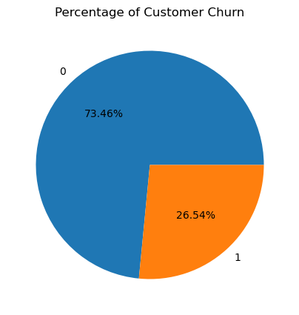
Exploratory Data Analysis - Customer Churn Visualization
Churn Rate = No. of users @ beginning – No. of users @ end x 100% Number of users at the beginning
Hence, 26.54% of customers churned, signifying huge losses i.e. 1869 customers.
Churn Rate of 26.54% is high especially if there are no new customers subscribing.
Usually, a churn rate of around 2% is considered good and at 8% and above is considered bad.

Slide 13
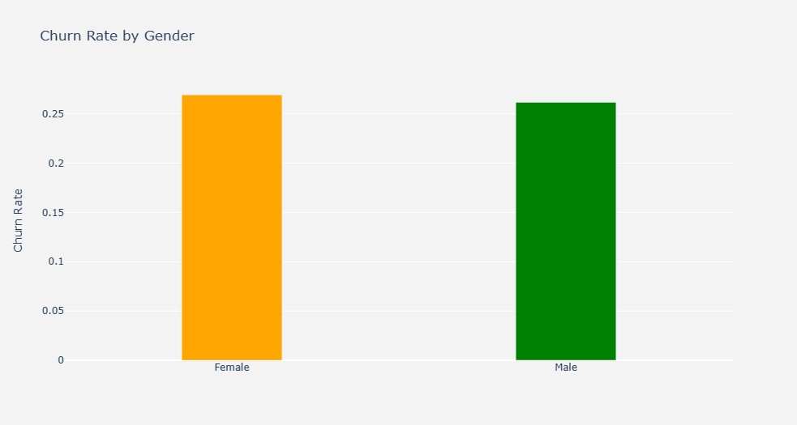
Churn Rate by Gender
The churn rate for females is slightly more than the churn rate for males.

Slide 14
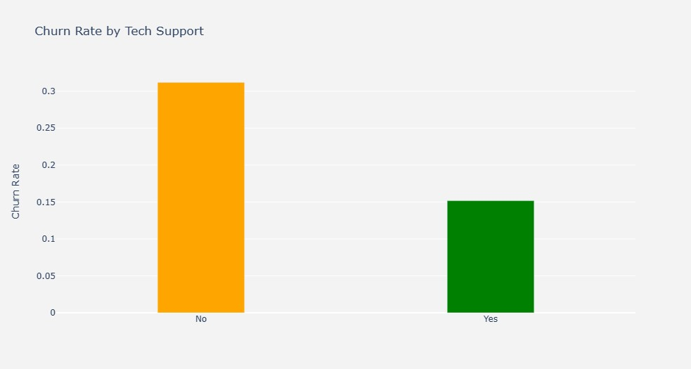
Churn Rate by Tech Support
Customers that do not contact Tech Support are more likely to churn.

Slide 15
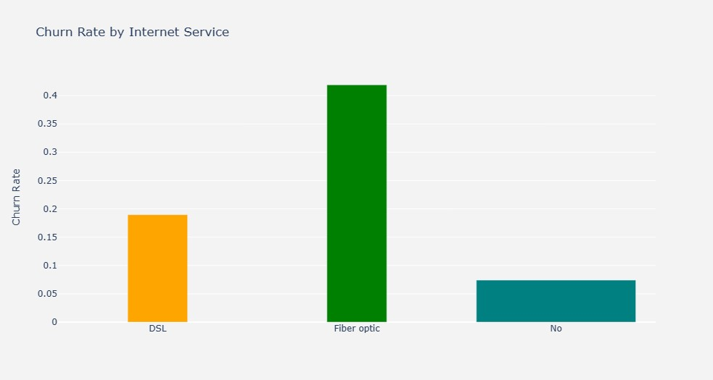
Churn Rate by Internet Service
Customers with fiber optic internet service are more likely to churn. This could be due to competition or the price differences of competitors.

Slide 16
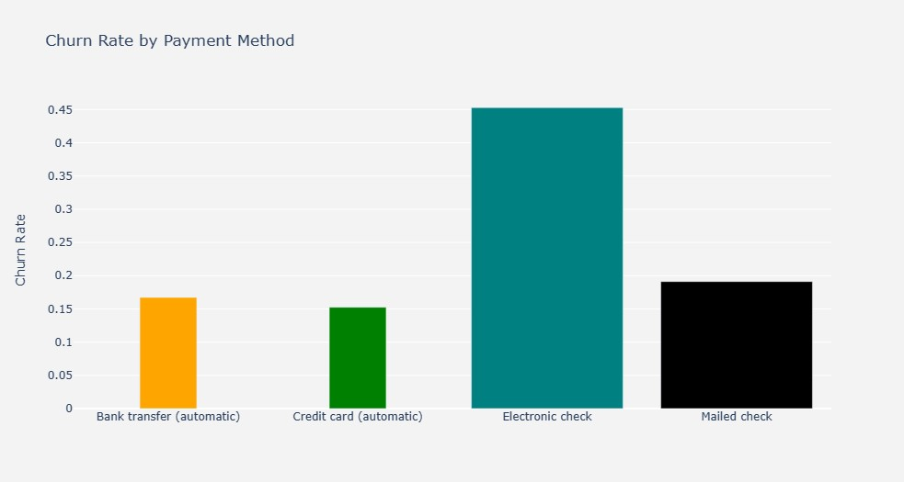
Churn Rate by Payment Method
Customers making payment using the electronic check are more likely to churn.

Slide 17
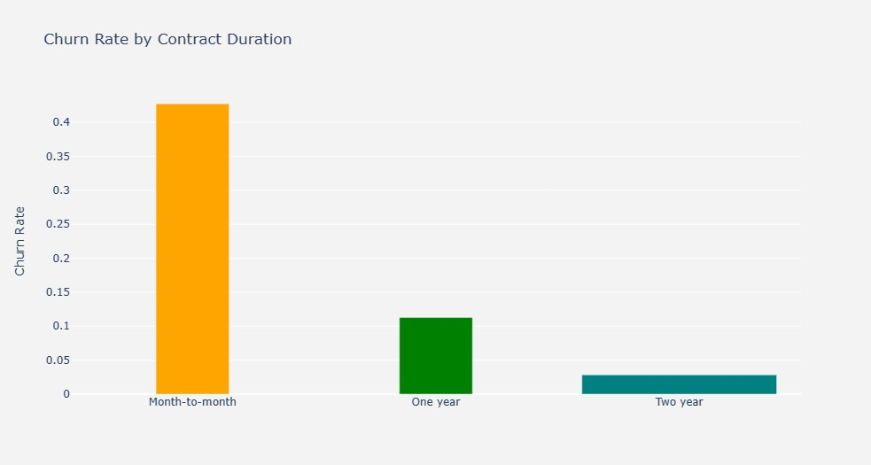
Churn Rate by Contract Duration
Customers with lower duration of contract i.e. month to month, are more likely to churn. While those with longer duration are less likely to churn.

Slide 18
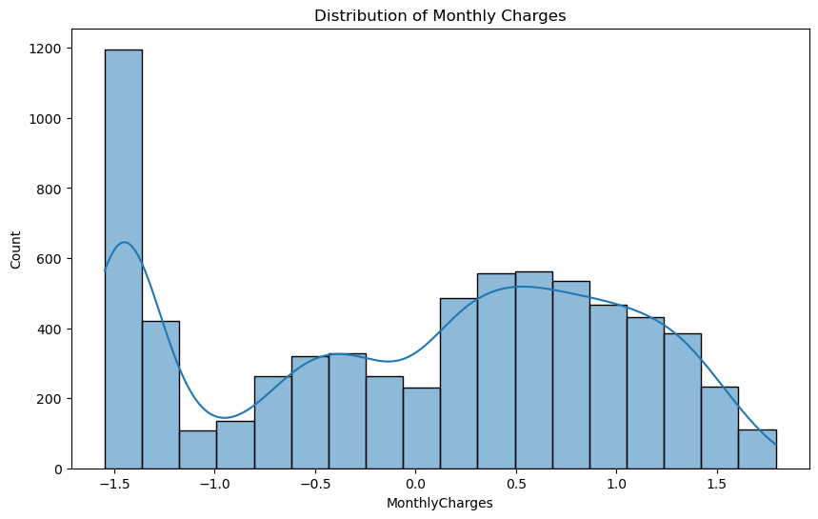
Univariate Analysis: Distribution of MonthlyCharges

Slide 19
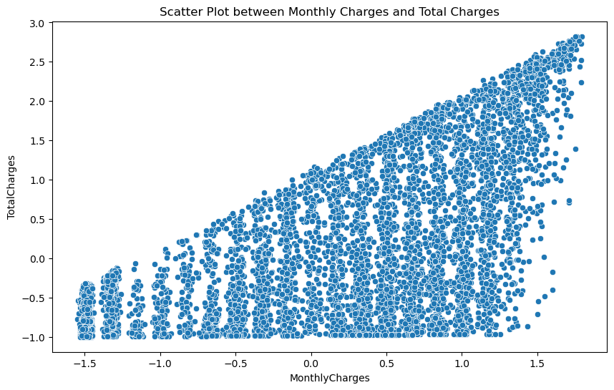
Bivariate Analysis: Scatter plot between MonthlyCharges and TotalCharges

Slide 20
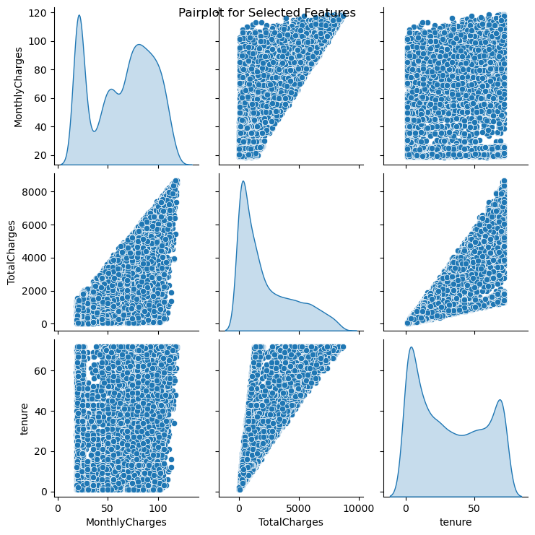
Multivariate Analysis: Pair plot for selected features

Slide 21
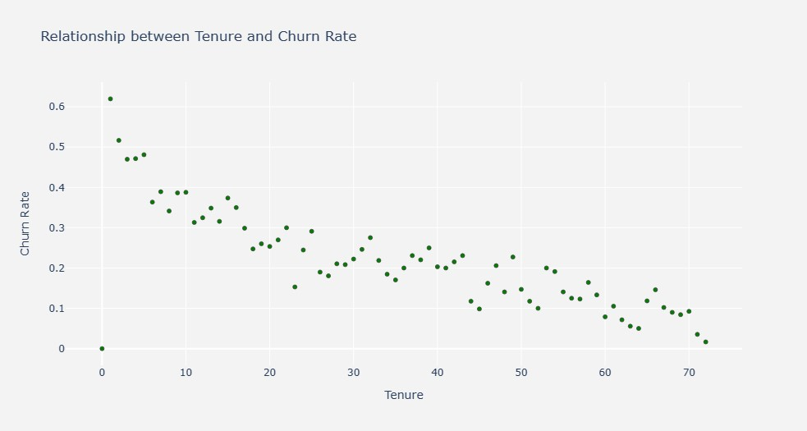
Relationship between Tenure and Churn Rate – higher tenure resulted in low churn rate

Slide 22
Data Preprocessing
Performed Feature Scaling on Tenure, Monthly Charges and Total Charges in order to bring them on the same scale.
Applied the feature scaling operation on dataset using fit transform() method.

Slide 23
Split the Data:
Create Feature variable X and Target variable y.
Split the data into training set (70%) and test set (30%)
X_train, X_test, y_train, y_test = train_test_split(X, y, test_size = 0.30, random_state = 50)
Fit the classification model
logmodel = LogisticRegression(random_state=50)
logmodel.fit(X_train,y_train)
Predict the value for new, unseen data
pred = logmodel.predict(X_test)
Find Accuracy using accuracy score method
logmodel_accuracy = round(metrics.accuracy_score(y_test, pred) * 100, 2)

Slide 24
Classification models
Fit the Logistic Regression model
Fit the K - Nearest Neighbor Model
Fit the Decision Tree Classification Model
Fit the Random Forest Classifier Model

Slide 25
Compare Several Models according to their Accuracies
Score Model
0 80.66 Logistic Regression
1 79.53 Random Forest
2 76.92 K-Nearest Neighbor
3 72.65 Decision Tree

Slide 26
Confusion Matrix
Confusion Matrix for Logistics Regression Model has the Maximum Accuracy Score of all the models.
True Negative (TN): 1391
False Positive (FP): 170
False Negative (FN): 238
True Positive (TP): 311
In the context of customer churn prediction, you would typically want to minimize false positives (customers wrongly predicted as churning) and false negatives (churning customers not identified by the model). The choice of which metric is most important depends on the specific business objectives and the cost associated with different types of errors.

Slide 27
Churn Prediction
Predicts the probability of Churn of each customer.
Data frame showcasing Probability of Churn of each customer.
customerID Probability_of_Churn
0 7590-VHVEG 0.608225
1 5575-GNVDE 0.049974
2 3668-QPYBK 0.369412
3 7795-CFOCW 0.024181
4 9237-HQITU 0.666956
​With this you can predict the likelihood that a customer will churn and certain measures can be taken to prevent churn.

Slide 28
Business Concerns:
False Positives vs. False Negatives:
False Positives (Type I Errors): Predicting a customer will churn when they won't. This could lead to unnecessary retention efforts for customers who have no intention of leaving.
False Negatives (Type II Errors): Predicting a customer won't churn when they will. This could result in losing customers who could have been retained.
The business should weigh the costs of these errors based on its specific context. For customer churn, false negatives (failing to identify customers who will churn) might be more concerning, as losing existing customers can be more costly than attempting to retain customers who are not actually at risk of churning.
However, it's essential to strike a balance between false positives and false negatives based on the business's specific goals and constraints.

Slide 29
Conclusion
Improving churn rate involves implementing strategies to retain customers and enhance overall customer satisfaction. Here are several strategies to consider:
1. Enhance Customer Service:
2. Customer Engagement:
3. Product/Service Enhancement:
4. Competitive Pricing:
5. Transparent Billing and Policies:
6. Proactive Customer Retention:
7. Customer Feedback and Surveys:
In summary, the solution to the customer churn problem will not only benefit ConnectTel in terms of revenue retention and cost savings but also position the company as an industry leader committed to customer satisfaction and innovation in telecommunications services.

